Slide 1
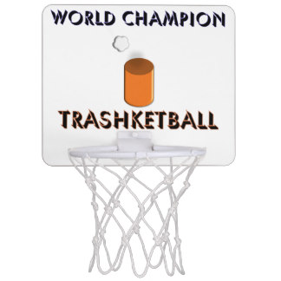
Native and Exploration Test Review

Slide 2
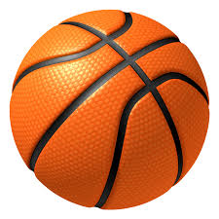
Why was the Mississippian culture more permanent that the early native cultures?

Slide 3
They grew crops through Horticulture

Slide 4
What was the most important crop grown by the Native Cultures?

Slide 5
Maize

Slide 6
What did the Natives build and use for burial and religious ceremonies?

Slide 7
Burial Mounds

Slide 8
What was the FIRST permanent settlement for England/Great Britain?

Slide 9
Jamestown

Slide 10
Who was the Spanish explorer who first explored GA looking for Gold, killed many natives and FAILED??

Slide 11
Hernando de Soto

Slide 12
How did the Native cultures diet affect their lifestyle?

Slide 13
Controlled where and how they lived.

Slide 14
Which native culture did the European explorers DRASTICALLY effect?

Slide 15
Mississippian

Slide 16
Where did Christopher Columbus THINK he landed until he died?

Slide 17
India

Slide 18
What were the two things the Mississippians built to protect their villages?

Slide 19
Palisades and Moats

Slide 20
What was the major cause of death for the Natives when the Europeans arrived?

Slide 21
Disease

Slide 22
What was the first permanent settlement for the Spanish?

Slide 23
St. Augustine

Slide 24
What was the name of the weapon the woodland culture created to kill wildlife in a more advanced way?

Slide 25
Bow and arrow

Slide 26
What was the MAJOR food source for the first native cultures? Why?

Slide 27
Meat Because they were nomadic and had to follow food

Slide 28
Which country in Europe was NOT allowed to settle in the New World because of the Line of Demarcation?

Slide 29
Portugal

Slide 30
What were the three French Settlements?

Slide 31
New Orleans, Mobile and Quebec

Slide 32
Which word means to move around to follow food? Paleo did this.

Slide 33
Nomadic

Slide 34
Who from England made many trips to the New World, and then got lost??

Slide 35
John Cabot

Slide 36
What is importing less than you export?

Slide 37
Mercantilism

Slide 38
What continent did the Natives travel from?

Slide 39
Asia

Slide 40
What religious organizations were started by the Spanish to spread Christianity to the natives?

Slide 41
Missions

Slide 42
What were the 3 reasons the Spanish wanted to settle?

Slide 43
God, Gold, and Glory

Slide 44
What weapon did the Paleo create to throw spears faster?

Slide 45
Atlatl

Slide 46
How did Mississippians build their houses?

Slide 47
Wattle and Daub

Slide 48
What type of knives did the Mississippians use?

Slide 49
Chert

Slide 50
How did the original Native Americans get to North America?

Slide 51
Crossed the Bering Land Bridge

Slide 52
WHo was forced to do the work in the Mississippian villages?

Slide 53
Commoners

Slide 54
Where in Georgia were the Spanish missions established?

Slide 55
Barrier Islands

Slide 56
Which SPanish explorer named Florida the “island of flowers”?

Slide 57
Ponce De Leon

