Slide 1
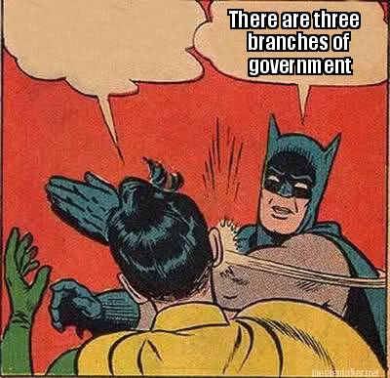
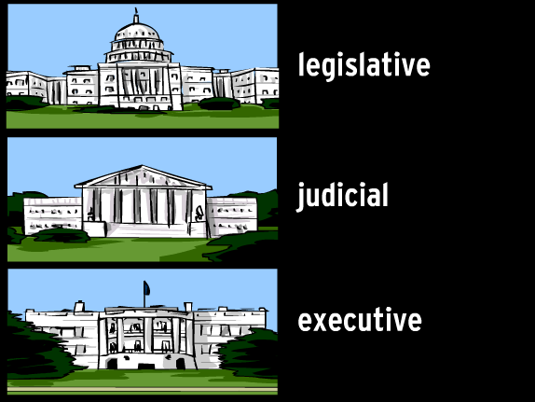

Slide 2
WHAT WAS THE FIRST GOVERNMENT IN AMERICA CALLED?

Slide 3
ARTICLES OF CONFEDERATION

Slide 4
WHO IS THE LEADER OF THE SUPREME COURT?

Slide 5
CHIEF JUSTICE

Slide 6
NAME TWO EXAMPLES OF CHECKS THAT BRANCHES HAVE OVER EACH OTHER.

Slide 7
Judicial Review, Presidential Veto, Legislation overriding a Veto, The Senate approving or denying Presidential appointments, Legislation impeaching the President

Slide 8
WHICH DOCUMENT WAS CREATED AT THE CONSTITUTIONAL CONVENTION IS 1787?

Slide 9
US CONSTITUTION

Slide 10
WHAT IS USED TO DECIDE WHICH CANDIDATE GETS THE ELECTORAL VOTES FROM EACH STATE?

Slide 11
POPULAR VOTE

Slide 12
WHAT ARE THE PRESIDENT’S THREE OPTIONS WHEN THEY GET A BILL?

Slide 13
SIT ON IT, VETO, PASS

Slide 14
WHICH BRANCH OF GOVERNMENT CREATES LAWS?

Slide 15
LEGISLATIVE BRANCH

Slide 16
HOW MANY MEMBERS ARE THERE IN THE SUPREME COURT? WHO APPOINTS THEM?

Slide 17
9, THE PRESIDENT

Slide 18
Thank you for preparing yourself for success! On tomorrow’s test, draw a picture of your favorite food at the top of your short answer paper! If you do this, you will receive 3 extra points on your grade! SHHHH, don’t tell anyone! If too many people find out, then no one gets points!

Slide 19
WHAT ARE LAWS ORIGINALLY CALLED BEFORE THEY ARE PASSED?

Slide 20
BILL

Slide 21
WHAT HAPPENS IF BILLS ARE NOT IDENTICAL IN BOTH HOUSES?

Slide 22
CONFERENCE COMMITTEE

Slide 23
NAME THE TWO MEN REPRESENTING GEORGIA AT THE CONSTITUTIONAL CONVENTION IN 1787.

Slide 24
WILLIAM FEW AND ABRAHAM BALDWIN

Slide 25
WHO IS THE LEADER OF THE HOUSE OF REPRESENTATIVES?

Slide 26
SPEAKER OF THE HOUSE

Slide 27
WHICH BRANCH OF GOVERNMENT INTERPRETS THE LAWS?

Slide 28
JUDICIAL

Slide 29
WHO DECIDES WHICH CASES THE SUPREME COURT HEARS?

Slide 30
THE SUPREME COURT

Slide 31
HOW OLD MUST YOU BE TO SERVE IN THE HOUSE OF REPRESENTATIVES?

Slide 32
25

Slide 33
HOW LONG ARE TERMS FOR THE SENATE?

Slide 34
6 YEARS

Slide 35
WHAT DECISION WAS MADE TO COMBINE THE VIRGINIA AND NEW JERSEY PLANS?

Slide 36
GREAT COMPROMISE

Slide 37
WHAT ARE THE REQUIREMENTS TO BE PRESIDENT?

Slide 38
35 YEARS OLD, NATURAL BORN CITIZEN AND 14 YEARS IN US

Slide 39
WHO IS THE LEADER IN THE SENATE?

Slide 40
VICE PRESIDENT

Slide 41
WHAT IS THE NAME FOR THE FIRST TEN AMENDMENTS TO THE US CONSTITUTION?

Slide 42
BILL OF RIGHTS

Slide 43
WHY IS THERE A SYSTEM OF CHECKS AND BALANCES?

Slide 44
TO PREVENT ANY GROUP FROM GAINING TOO MUCH POWER.

Slide 45
WHAT IS JUDICIAL REVIEW?

Slide 46
THE ABILITY OF THE JUDICIAL BRANCH TO RULE LAWS UNCONSTITUTIONAL

Slide 47
WHICH BRANCH OF GOVERNMENT ENFORCES THE LAWS?

Slide 48
EXECUTIVE

Slide 49
WHICH PLAN WAS BASED ON PROPORTIONALITY IN THE LEGISLATIVE BRANCH? HOW MANY HOUSES?

Slide 50
VIRGINIA PLAN, 2

Slide 51
HOW LONG ARE TERMS FOR PRESIDENT?

Slide 52
4 YEARS

Slide 53
GEORGIA RATIFIED THE CONSTITUTION IN WHAT ORDER?

Slide 54
4TH

Slide 55
HOW DO WE ELECT PRESIDENTS IN AMERICA?

Slide 56
ELECTORAL COLLEGE

Slide 57
WHAT PERCENTAGE OF THE VOTE IS NEEDED TO ORIGINALLY PASS A BILL? HOW ABOUT AFTER A VETO?

Slide 58
51% MAJORITY
2/3 VOTE

Slide 59
WHICH PLAN FOR REPRESENTATION IS BASED ON EQUALITY? HOW MANY HOUSES DID THAT PLAN WANT?

Slide 60
NEW JERSEY PLAN, 1

Slide 61
WHAT IS THE PRESIDENTIAL CABINET?

Slide 62
15 ADVISORS TO THE PRESIDENT

Slide 63
HOW MANY MEMBERS DOES EACH HOUSE OF CONGRESS HAVE?

Slide 64
SENATE- 100
HOR- 435

Slide 65
WHICH BRANCH OVER GOVERNMENT IS THE LARGEST?

Slide 66
EXECUTIVE

Slide 67
NAME THE THREE PARTS OF THE DECLARATION OF INDEPENDENCE.

Slide 68
PREAMBLE, GRIEVANCES, ACTUAL DECLARATION

Slide 69
HOW MANY JUSTICES ARE IN THE SUPREME COURT?

Slide 70
9

