Slide 1
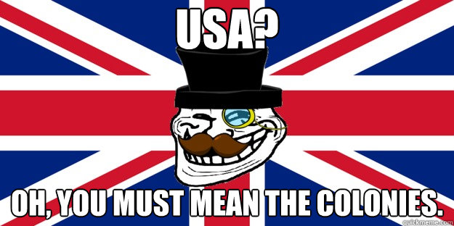
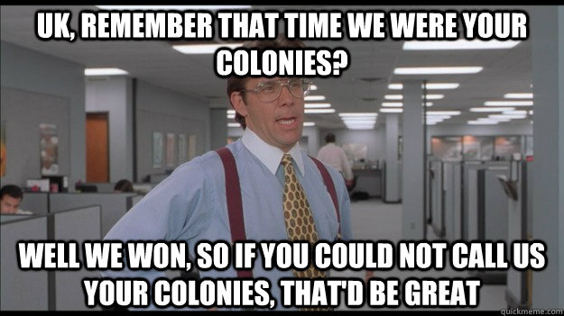
Trashketball
YOU WILL NEED OUT A BLANK SHEET OF NOTEBOOK PAPER AND SOMETHING TO WRITE WITH.
REMEMBER – YOUR TEAM CAN AND WILL BE PENALIZED FOR EXCESSIVE TALKING, SIGNS OF CHEATING, EXCESSIVE CELEBRATION

Slide 2
Which Trustee traveled with the new colonists to the New World?
James Oglethorpe

Slide 3
What is the name of the ship that James Oglethorpe and Georgia’s first colonists traveled to the New World on?
SHIP ANN

Slide 4
What is the name of the economic policy in which a country imports less than it exports?
MERCANTALISM

Slide 5
Which governor was disliked by the colonists?
JOHN REYNOLDS

Slide 6
When was slavery allowed in the colony of Georgia?
1750

Slide 7
Which group settled in Darien?
HIGHLAND SCOTS

Slide 8
Name 3 reasons for colonizing Georgia.
ECONOMICS
DEFENSE
PHILANTHROPY

Slide 9
How did the government change from the Trustee Period to the Royal Period?
Common people were allowed to be elected to the legislature and help create laws.
Common people had no say under Trustee rule. Also, a court system was established.
Royal Governor was appointed to be in charge.

Slide 10
What was the name of the place that Oglethorpe and the Ship Ann landed to begin the colony of Georgia?
YAMACRAW BLUFF

Slide 11
Who was the chief of the Yamacraw Indians?
CHIEF TOMOCHICHI

Slide 12
Savannah is known for what in the layout of the city?
OPEN SQUARES

Slide 13
Name 2 reasons that there was discontent amongst the colonists.
BAN ON RUM
BAN ON SLAVERY
RESTRICTIONS ON LAND INHERITENCES
(WILL ALSO ACCEPT JEALOUSY OF SOUTH CAROLINIANS)

Slide 14
What does bicameral mean?
TWO HOUSES

Slide 15
Who was the translator for Chief Tomochichi and James Oglethorpe?
MARY MUSGROVE

Slide 16
Which 3 countries colonized the New World?
SPAIN
ENGLAND
FRANCE

Slide 17
What was the first permanent English settlement in the New World?
JAMESTOWN

Slide 18
Which governor left office due to sickness?
HENRY ELLIS

Slide 19
Which group of German colonists formed the settlements Ebenezer and New Ebenezer?
SALZBURGERS

Slide 20
Who granted the charter to start the colony of Georgia?
KING GEORGE II

Slide 21
What royal governor promoted cash crops and slavery?
JAMES WRIGHT

Slide 22
Name 3 of the 4 groups of people that were not allowed in the Georgia colony?
CATHOLICS
SLAVES
LAWYERS
LIQUOR DEALERS

Slide 23
Why did the Salzburgers come to Georgia?
RELIGIOUS FREEDOM FROM THE CATHOLICS

Slide 24
Which group of Indians lived in the area that Oglethorpe and the colonists settled?
YAMACRAW INDIANS

Slide 25
In what year did King George II grant a charter to Oglethorpe and his group of trustees?
1732

Slide 26
Why did the Highland Scots come to Georgia?
FOR DEFENSE. THEY WERE KNOWN AS GREAT SOLDIERS.

Slide 27
Georgia was created to protect which British Colony?
SOUTH CAROLINA

Slide 28
Name 3 of the 5 products that were to be produced in the new colony of Georgia.
Wine, Rice, Indigo, Silk, Tobacco

Slide 29
Which royal governor created a bicameral legislature?
JOHN REYNOLDS

Slide 30
Name the three royal governors of Georgia.
JOHN REYNOLDS, HENRY ELLIS, JAMES WRIGHT

